Slide 1
Do this now! (on paper preferred)
Write a program to calculate the average age of a group of people, of unknown size
Use a negative number as the 'sentinel' (when to stop)
Note: We have not learned about lists yet... so don't use a list. You don't need one, and using a list would be inefficient.

Slide 2
Chapter 4
Working with Strings

Slide 3
Sequence of characters
Strings are sequencer of characters.
A string is indicated between ' ' or " "
It doesn't matter which you use, but:
s = "This isn't not good" s = 'This "is" good too!'

Slide 4
And then there is """ """
triple quotes preserve both the vertical and horizontal formatting of the string
allows you to type tables, paragraphs, whatever and preserve the formatting
"""this is
a test
today"""
Notes:
三重引号保留了字符串的垂直和水平格式
允许您键入表格，段落，任何和保留格式

Slide 5
Non-printing (escape) characters
If inserted directly, are preceded by a backslash (the \ character)
new line '\n'
tab '\t'
backslash '\\'
and others...
Notes:
如果直接插入，前面有反斜杠
换行' \ n '
选项卡“\ t”
反斜杠“\ \”
和其他…

Slide 6
String Representation
every character is "mapped" (associated) with an integer
UTF-8, subset of Unicode, is such a mapping
the function ord() takes a character and returns its UTF-8 integer value, chr() takes an integer and returns the UTF-8 character.
You occasionally need to watch out for special characters like © ☺
Notes:
每个字符都与一个整数“映射”(关联)
Unicode的子集UTF-8就是这样一种映射
函数ord()接受一个字符并返回其UTF-8整数值，chr()接受一个整数并返回UTF-8字符。
你偶尔需要小心等特殊字符©☺

Slide 7
Subset of UTF-8
See Appendix D for the full set
Notes:
UTF stands for Unicode Transformation Format. The '8' means it uses 8-bit blocks to represent a character.

Slide 8
The Index
Because the elements of a string are a sequence, we can associate each element with an index, a location in the sequence:
positive values count up from the left, beginning with index 0
negative values count down from the right, starting with -1
Notes:
Negative indices is not a common language feature (e.g. in many languages, sequence[-1] would produce an error).
因为字符串的元素是一个序列，我们可以将每个元素与一个索引关联，即序列中的一个位置:
正值从左起，从索引0开始
负数从右边开始倒数，从-1开始

Slide 9
Accessing an element
A particular element of the string is accessed by the index of the element surrounded by square brackets [ ]
hello_str = 'Hello World'
print(hello_str[1]) => prints e
print(hello_str[-1]) => prints d
print(hello_str[11]) => ERROR
Notes:
字符串的特定元素由方括号[]包围的元素索引访问
hello_str = 'Hello World'
print (hello_str[1]) =比;打印e
print (hello_str[1]) =比;打印d
print (hello_str[11]) =比;错误

Slide 10
Slicing: the rules
slicing is the ability to select a subsequence of an overall sequence
uses the syntax [start:finish], where:
start is the index of where we start the subsequence
finish is the index of one after where we end the subsequence
if either start or finish are not provided, it defaults to the beginning of the sequence for start and the end of the sequence for finish
Notes:
切片是选择整个序列的子序列的能力
使用语法[start:finish]，其中:
start是子序列的下标
finish是子序列结束后的索引1
如果没有提供start或finish，则默认为start序列的开始和finish序列的结束

Slide 11
half open range for slices
slicing uses what is called a half-open range
the first index is included in the sequence
the last index is one after what is included
Notes:
切片使用所谓的半开放范围
第一个索引包含在序列中
最后一个索引是包含内容之后的索引

Slide 14
Extended Slicing
also takes three arguments:
[start:stop:step]
defaults are:
start is beginning, stop is end, step is 1
s = 'hello world'
s[0:11:2] ⇒ 'hlowrd'
every other letter
Notes:
也有三个参数:
(启动,停止,步骤):
默认值是:
开始就是开始，停止就是结束，每一步都是1
s = 'hello world'
年代[0:11:2]hlowrd”
其他的信

Slide 16
Some Python idioms
idioms are Python “phrases” that are used for a common task that might be less obvious to non-Python folk
how to make a copy of a string:
s = 'hi mom'
t = s[:]
how to reverse a string
s = "madam I'm adam"
reversed = s[::-1]
Notes:
惯用语是Python的“短语”，用于一个对非Python人员可能不太明显的常见任务
如何复制一个字符串:
s = '嗨，妈妈'
t = s [:]
如何反转字符串
女士，我是亚当。
逆转= s [:: 1]

Slide 17
Sequences are iterable
The for loop iterates through each element of a sequence in order. For a string, this means character by character:
Notes:
for循环按顺序遍历序列中的每个元素。对于字符串，这意味着一个字符接一个字符:

Slide 18
what does a + b mean?
what operation does the above represent? It depends on the types!
two strings => concatenation
two integers => addition
the + operator is overloaded.
The operation that + performs depends on the types it is working on
Notes:
上面的操作代表什么?这取决于类型!
两个字符串=;连接 ‘abc’+’def’=‘abcdef’
两个整数=;除了 ’10’+’5’=’105’
操作符被重载。
+执行的操作取决于它所处理的类型

Slide 19
Membership operations
can check to see if a substring exists in the string, the in operator. Returns True or False
word = 'aabbccdd'
'a' in word ⇒ True
'abb' in word ⇒ True
'x' in word ⇒ False
Don't use in to compare for equality, use == E.g. if user_entry == password
Notes:
If you use 'in' for comparison, you may get unwanted positives, e.g. if "bob" in "bobby" is not the same as if "bob" == "bobby".
可以检查字符串中是否存在子字符串，即in操作符。返回真或假
词= ' aabbccdd '
“一”字真的
“abb”字真的
“x”在字(词)假
不要使用在比较平等,使用= =。如果user_entry ==密码

Slide 20

Strings are immutable
You cannot change one once you make it:
word = 'spam'
word [1] = 'l' → ERROR
However, you can use it to make another string (copy it, slice it, etc.)
new_word = word[:1] + 'l' + word[2:]
word → 'spam'
new_word → 'slam'
Notes:
你不能改变一个一旦你做了:
词= '垃圾'
词[1]= ' l '→错误
但是，您可以使用它来创建另一个字符串(复制它，切片它，等等)。
new_word = word[:1] + 'l' + word[2:]
词→“垃圾邮件”
new_word→“大满贯”

Slide 21
String methods and functions

Slide 22
Functions, first cut
A function is a part of a program that performs some operation. Its details are hidden (encapsulated); we only need to know about its interface (how to use it).
A function takes some number of inputs (arguments) and returns a value based on the arguments and the function's operation.
Notes:
函数是执行某些操作的程序的一部分。它的细节被隐藏(封装);我们只需要知道它的接口(如何使用它)。
函数接受一定数量的输入(参数)，并根据参数和函数的操作返回一个值。

Slide 23
Function: len
The len function takes as an argument a string or other sequence and returns an integer, the length of the item.
word = 'Hello World'
len(word) ⇒ 11 # space is counted
Notes:
len函数以字符串或其他序列作为参数，并返回一个整数，即项的长度。
word = 'Hello World'
len(词)11 #空间计算

Slide 24
String method
a method is a variation on a function
like a function, it represents a small program
like a function, it has input arguments and an output
Unlike a function, it is applied in the context of a particular object.
This is indicated by the dot notation invocation
Notes:
方法是函数的变体
像函数一样，它代表一个小程序
与函数一样，它也有输入参数和输出
与函数不同，它应用于特定对象的上下文中。
这是由点表示法调用表示的

Slide 25
Example
upper is the name of a method. It generates a new string that has all upper case characters of the string it was called with.
text = 'Python Rules!'
text.upper() ⇒ 'PYTHON RULES!'
The upper() method was called in the context of text, indicated by the dot between them.
Notes:
upper是一个方法的名称。它生成一个新的字符串，其中包含调用它的字符串的所有大写字符。
“Python规则!”
text.upper()“PYTHON规则!”
upper()方法是在文本上下文中调用的，由它们之间的点表示。

Slide 26
more on dot notation
in general, dot notation looks like:
object.method(…)
It means that the object to the left of the dot is calling the method to the right of the dot that is associated with that object's type.
The methods that can be called are tied to the type of the object calling it. Each type has different methods.
Notes:
一般来说，点符号看起来像:
object.method(…)
它意味着位于点左侧的对象正在调用与该对象类型关联的点右侧的方法。
可以调用的方法绑定到调用它的对象的类型。每种类型都有不同的方法。

Slide 27
find
word = 'hello'
word.find('l') # find index of 'l' in my_string
⇒ 2
Note how the method find operates on the string object, word, and the two are associated by using the “dot” notation: word.find('l')
Terminology: the thing in parenthesis, i.e. the 'l' in this case, is called an argument.
Notes:
词= '你好'
查找my_string中'l'的索引
2
注意方法find是如何操作字符串对象word的，并且这两个对象通过使用“点”符号相关联:word.find('l')
术语:括号里的东西，也就是这里的“l”，叫做参数。

Slide 28
Chaining methods
Methods can be chained together.
Perform first operation, yielding an object
Use the yielded object for the next method
my_string = 'Python Rules!'
my_string.upper() ⇒ 'PYTHON RULES!'
my_string.upper().find('O')
⇒ 4
Notes:
方法可以链接在一起。
执行第一个操作，生成一个对象
为下一个方法使用yield对象
my_string = 'Python规则!'
my_string.upper()“PYTHON规则!”
my_string.upper();(“O”)
4

Slide 29
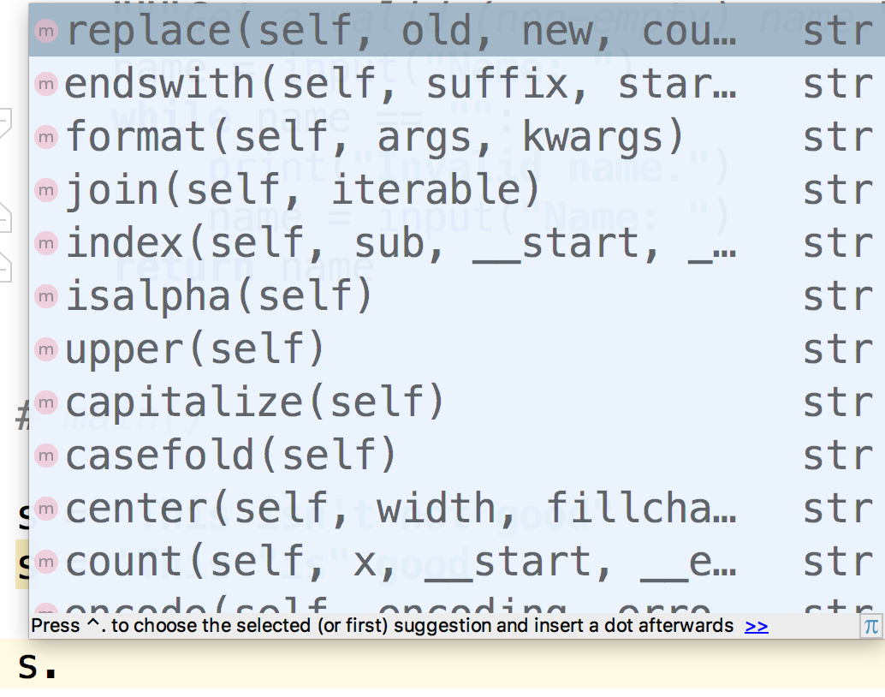
How can you find out the methods?
You can use the IDE to find available methods for any type. You enter a variable of the type, followed by the '.' (dot) and wait/tab.
Remember, methods match with a type. Different types have different methods.
If you type a method name, the IDE will remind you of the needed and optional arguments.
Notes:
您可以使用IDE为任何类型查找可用的方法。输入该类型的变量，后跟'。(点)和等待/tab。
记住，方法与类型匹配。不同的类型有不同的方法。
如果您键入一个方法名，IDE将提醒您需要的和可选的

Slide 31
String methods - changing case
upper, lower, title, swapcase
Example:
>>> s = "Hello world"
>>> s.upper()
'HELLO WORLD'
>>> s.title()
'Hello World'
Note that these do NOT modify s, but return a new string
Strings are immutable!
Notes:
上，下，标题，互换格
例子:
在在在s = "Hello world"
在在在s.upper ()
“HELLO WORLD”
在在在s.title ()
“Hello World”
注意，它们不修改s，而是返回一个新字符串
字符串是不可变的!

Slide 32
String methods - testing strings
How could you check a filename has the right extension?
file_name = input("Text file name: ")
if not file_name.endswith(".txt"):
print("Let me stop you right there")
Answer this now: How could you check that a phone number (string) has the right area code for Queensland (‘07’) at the start?
Notes:
… startswith(‘07’)
如何检查文件名的扩展名是否正确?
file_name = input("文本文件名:")
如果不是file_name.endswith (. txt):
打印(“让我打断你一下”)
现在回答这个问题:你如何检查一个电话号码(字符串)是否有昆士兰(' 07 ')的区号?

Slide 33
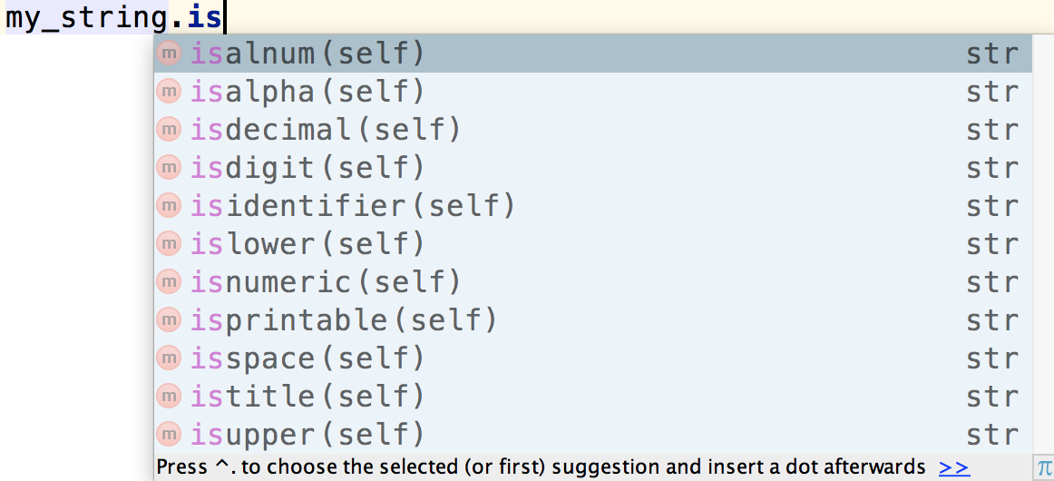
String methods - testing strings
Many string methods start with is… (a great prefix for a Boolean-returning function)
What would you use any of these for?

Slide 34
Write code to produce:
00
03
06
09
12
Use a loop that would allow you to produce similar sequences. E.g. 5 to 40 in steps of 5, or 3 to 75 in steps of 2...

Slide 35
String formatting

Slide 36
String formatting, better printing
So far, we have just used the defaults of the print function
We can do many more complicated things to make that output “prettier” using the format string method.
print("Sorry, is this the {} minute {}?".format(5, 'ARGUMENT'))
prints Sorry, is this the 5 minute ARGUMENT?
Notes:
到目前为止，我们只是使用了print函数的默认值
使用format string方法，我们可以做很多更复杂的事情来让输出“更漂亮”。
打印(“对不起，这是{}分钟{}吗?”格式(5“论证”))
抱歉，这是5分钟参数吗?

Slide 37
map args to {}
The string is modified so that the {} elements in the string are replaced by the format method arguments
The replacement is in order: first {} is replaced by the first argument, second {} by the second argument and so forth.
print("First: {}, Second: {} value".format(x, y))
Notes:
修改字符串，以便将字符串中的{}元素替换为格式方法参数
替换的顺序是:first{}被第一个参数替换，second{}被第二个参数替换，依此类推。
打印("第一个:{}，第二个:{}值")。格式(x, y))

Slide 39
Format string
the content of the curly bracket elements are the format string, descriptors of how to organize that particular substitution.
types are the kind of thing to substitute, numbers indicate total spaces.
{:.2f} {:4} {:>10s}
Notes:
花括号元素的内容是格式字符串、如何组织特定替换的描述符。
类型是可以替代的东西，数字表示空格总数。

Slide 40
Each format string
Each bracket looks like
{:align width .precision type}
align is optional (defaults: left for strings, right for numbers)
width is how many spaces (default: just enough)
.precision is for floating point rounding (default: no rounding)
type is the expected type (error if the arg is the wrong type), this is optional in some cases
Notes:
每个括号看起来像
{:align width .precision type}
align是可选的(默认:left表示字符串，right表示数字)
宽度是多少空格(默认:刚刚足够)
.precision用于浮点舍入(默认:不舍入)
类型是期望的类型(如果参数是错误的类型，则为错误)，在某些情况下这是可选的

Slide 42
Floating Point Precision
Can round floating point to specific number of decimal places

Slide 43
Do this now
Write a print statement using the format method to print like:
name = "Monty"
money = 73.6
# TODO: output with string formatting
Output: Monty has $73.60

Slide 44
More string formatting
We can customise the formatting even more:
{arg : fill align sign # 0 width , .precision type}
That's a lot, so let's look at the details
Notes:
我们可以定制的格式，甚至更多:
{arg: fill align sign # 0 width， .precision type}
太多了，让我们看看细节

Slide 45
arg
To override the {}-to-argument matching we have seen, you can indicate the argument you want in the bracket
if other descriptor stuff is needed, it goes behind the arg, separated by a :
Notes:
要覆盖我们看到的{}到参数匹配，您可以在方括号中指出您想要的参数
如果需要其他描述符的东西，它在arg后面，用a隔开:

Slide 46
example
args are before the :, format after
for example {1:0=+10d} means:
1 → second (count from 0) arg of format, 35
: → separator
0= →fill with 0's
+ → plus or minus sign
10d→ occupy 10 spaces (left justify) decimal
Notes:
参数在:的前面，格式在后面
例如，{1:0=+10d}表示:
1→第二(从0)数的参数格式,35
:→分离器
0 =→充满0
+→正负符号
10 d→占用空间(左对齐)小数

Slide 47
nice for tables

Slide 48
Iteration

Slide 49
Iteration through a sequence
We can use the for statement for iteration, such as the elements of a list or a string
We use the for statement to process each element of a list, one element at a time
for item in sequence:
suite
Notes:
我们可以使用for语句进行迭代，比如列表或字符串的元素
我们使用for语句来处理列表中的每个元素，一次一个元素

Slide 51
enumerate function
The enumerate function returns two values: the index of an element and the element itself
Can use it to iterate through both the index and element simultaneously, doing dual assignment
Notes:
enumerate函数返回两个值:元素的索引和元素本身
是否可以使用它同时遍历索引和元素，执行双重赋值

Slide 52
Notes:
Interesting: else for a for or while only runs when the loop completes without breaking out.

Slide 53
split function
The split function will take a string and break it into a list containing multiple new string parts depending on the argument character.
by default, if no argument is provided, split is on any whitespace character (tab, blank, etc.)
you can assign the pieces with multiple assignment if you know how many pieces are yielded.
Notes:
split函数将获取一个字符串，并根据参数字符将其分解为包含多个新字符串部分的列表。
默认情况下，如果没有提供参数，分割是在任何空白字符(制表符、空格等)。
你可以分配与多重分配，如果你知道多少块是产生。

Slide 54
Example: reorder a name

